Slide 1


PANIMALAR ENGINEERING COLLEGE
Department of Electronics and Instrumentation Engineering
SMART EMBEDDED FRAMEWORK USING ARDUINO AND IOT FOR REAL-TIME NOISE AND AIR POLLUTION MONITORING AND ALERT SYSTEM
Batch No: 33
Batch Members:
B.Arvind Raghavendhar (211418107009)
D.Dhayalan (211418107023)
B.Manoj kumar (211418107050))
Internal Guide:
Mr.G.Venkatesh, M.E.,
Supervisor
Professor,
Department of EIE,
Panimalar Engineering College

Slide 2
ORGANIZATION
Introduction
Objective of the project
Existing System/ Literature Survey
Problem Identification
Proposed system - Block Diagram
Flowchart & Algorithm Explanation
Results & Discussions
Conclusion & Future Work
References

Slide 3
INTRODUCTION
This system uses CO2 sensor, noise sensor, arduino NANO, 16X2 LCD, buzzer and an exhaust fan.
The CO2 sensor measures the carbon di-oxide level in auditorium and noise sensor is used to measure the noise dB if both sensor values is more than threshold value it alerts the user by displaying alert message while ringing the buzzer.
It automatically runs the exhaust fan to until the CO2 comes to normal level.

Slide 4
OBJECTIVE
•To surveillance the carbon di-oxide and noise produced in indoor auditorium.
•To alert the user to take precautionary actions.
To help user avoid pollution.

Slide 5
LITERATURE SURVEY
TITLE | AUTHOR | JOURNAL | REMARKS
"A Raspberry pi Controlled Cloud based air and sound pollution monitoring system with temperature and humidity sensing" | Arnab Kumar Saha,sachet sircar,Priyasha Chatterjee | In 2018 IEEE 8th Annual Computing and Communication Workshop and Conference (CCWC) (pp. 607-611). IEEE | An IOT-based method to monitor the Air Quality Index and the Noise Intensity of a region, have been proposed.
"Building an Internet of Things (IoT) Air Quality Sensing platform on Amazon Web Services (AWS)” | Bryce Christensen | Doctoral dissertation, Queensland University of Technology. | The methodology for data consumption, sensor hardware, security configuration for use on AWS and the visualisations, websites and APIs developed for data delivery.
IoT Based Air Pollution Monitoring System” | Anand Jayakumar A, Praviss Yesyand T K | The influence on climate regulation and noise and air pollution. Environmental Pollution, 245, 844-852. | The influence on climate regulation and noise and air pollution. Environmental Pollution, 245, 844-852.

Slide 6
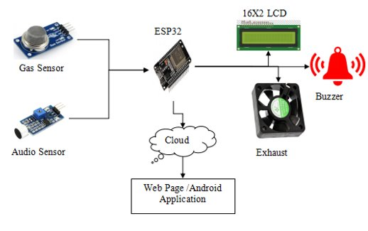
BLOCK DIAGRAM OF PROPOSED SYSTEM

Slide 7
PROBLEM IDENTIFICATION/
LIMITATIONS OF EXISTING SYSTEM
There is CO2 in the air that can’t be seen. which can cause harm if it is let for a long period of time.​
​
Noise also affects the mental health of the people if they are exposed to high db level of sound.​
​
This system’s purpose is to reduce the air and noise pollution and let the user feel safety and comfort.​

Slide 8
OVERVIEW OF THE PROPOSED WORK
The proposed system is mainly concentrated on the indoor air pollution monitoring to avoid the spread of COVID-19.​
It measures the carbon di-oxide and noise produced in indoor auditorium and alerts the user to take preventive measures in the auditorium. ​
Exhaust fan is used to ventilate the air in auditorium.​

Slide 9
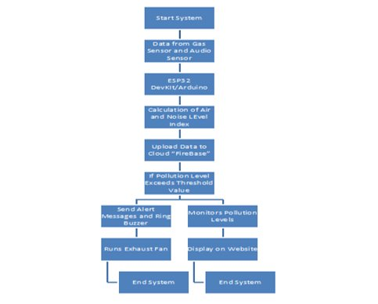
FLOW CHART OF PROPOSED SYSTEM

Slide 10
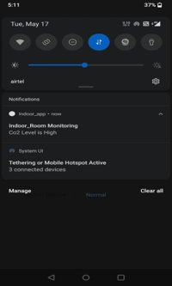
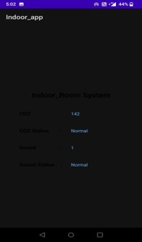
RESULTS & DISCUSSIONS
Figure:mobile alert
Figure:Mobile application

Slide 11
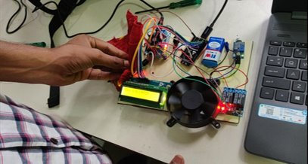
PROTOTYPE & EXPERIMENTAL RESULT
It enables continuous monitoring and storing of data with respect to air and sound quality.​
It alerts the user to take preventive measures.​
The cost friendliness, efficiency, low power, fast data transfer and user friendliness are the major benefits of this system.​

Slide 12
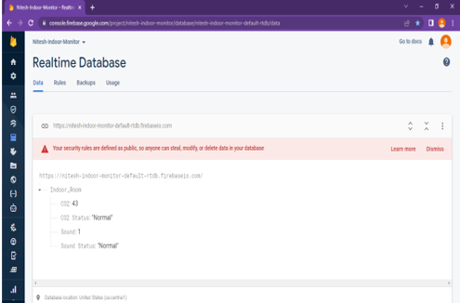
PROTOTYPE & EXPERIMENTAL RESULT
Figure: FireBase Status

Slide 13
REFERENCES
Nowshin, N., & Hasan, M. S. (2021, January). Microcontroller Based Environmental Pollution Monitoring System though IoT Implementation. In 2021 2nd International Conference on Robotics,Electrical and Signal Processing Techniques (ICREST) (pp. 493-498). IEEE
Filigrana, P., Milando, C., Batterman, S., Levy, J. I., Mukherjee, B., & Adar, S. D. (2020). Spatiotemporal variations in traffic activity and their influence on air pollution levels in communities near highways Atmospheric Environment, 242, 117758.
Christensen, B. (2021). Building an internet of things (IoT) air quality sensing platform on Amazon web services (AWS) (Doctoral dissertation, Queensland University of Technology).
Barton, B. T., Hodge, M. E., Speights, C. J., Autrey, A. M., Lashley, M. A., & Klink, V. P. (2018). Testing the AC/DC hypothesis: Rock and roll is noise pollution and weakens a trophic cascade. Ecology and Evolution, 8(15), 7649-7656.

Slide 14


